Slide 1



11 March 2023
Making Climate a Class
Worldwide Teach-In for Climate PH
Instagram: https://www.instagram.com/worldwideteachin_ph
Twitter: https://twitter.com/wwteachin_ph
Website: worldwideteachin.org

Slide 2

About
A climate teach-in is a bottom up educational event, focused on just solutions to the climate crisis in local communities and globally.

Slide 3
About
Teach-ins can be anywhere people come together; at colleges, universities, primary, middle and secondary schools, museums, or in faith or civil society communities.

Slide 4
Rationale
The effects of climate change are progressing and for the past year, different parts of the world suffered from disasters due to imbalances in climate. This leads us to engage with two ideas: that the time is very short and that realistic solutions are possible.

Slide 5
Rationale
As a response, the program was devised in order to encourage people around the world to conduct their own teach-in.

Slide 6
The Movement
Together with global partners, Bard GPS aims to “educate leaders to bring social and environmental justice to business, policy and education.”

Slide 7
The Movement
In line with this, the project aims to engage global citizens to issues on climate change and climate justice through different forms of educational forums that stimulates “solution-oriented” discussion among partakers - a Climate Teach-in.

Slide 8

HOW TO CONDUCT A CLASSROOM TEACH-IN?

Slide 9
THE BARD MODEL
We request all climate-concerned faculty on campus– from artists to philosophers to scientists– to spend 30 minutes on climate in their classes sometime around March 29th. These are NOT climate experts—just climate concerned teachers.

Slide 10
THE BARD MODEL
For the first 15 minutes, faculty discuss how people in each of their fields are helping solve climate change: again– economists, chemists, writers, sociologists, mathematicians, health scientists, everyone.

Slide 11
THE BARD MODEL
For the second half, zoom in an alum who is actually doing this work. Or if you can’t find an alum, then a professional or a colleague who is a climate expert.
Leave time for discussion with your students.

Slide 12
THE BARD MODEL
DONE!

Slide 13
THE BARD MODEL
This is an easy way for faculty to focus on climate from a career perspective, helping young people who are interested in psychology see how they could be a climate psychologist; how a musician could be a climate musician; or how a business student could work on business climate solutions.

Slide 14
FAQ
Can we modify the Bard Model?
Answer: YES!

Slide 15
POSSIBLE TEACH-IN TOPIC PER FIELD & SOME EXAMPLES

Slide 16
Teach-in Topics
Accounting: Discuss the Climate Accounting Project as a response to climate change. Is it effective? Why or why not?

Slide 17
Teach-in Topics
Anthropology: Study how Indigenous Peoples are affected by climate change. How does renewable energ ventures affect ancestral lands?

Slide 18
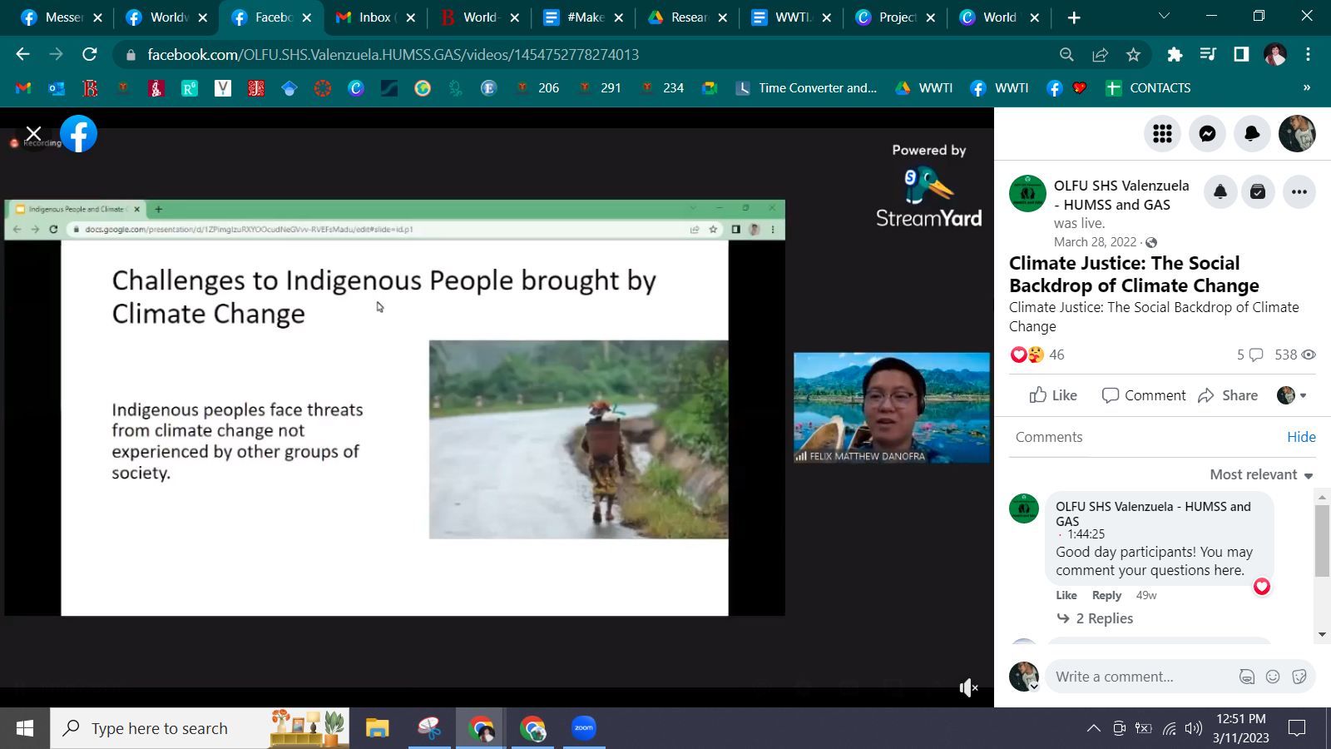
Teach-in Topics

Slide 19
Teach-in Topics
Archaeology: Rising seas threaten certain archaeological sites; how can archaeologists fight climate change? When has climate been different in the past and how have people responded to it?

Slide 20
Teach-in Topics
Art: Investigate artists who have responded to climate change in their art. Is art an effective social commentary for this issue? Can you design climate-conscious art?

Slide 21
Teach-in Topics
Art History: What do you think of the climate protesters who sloshed soup on a Van Gogh painting recently? Some protest the funding of museums by oil companies; should arts organizations divest from benefactors who are warming the globe?

Slide 22
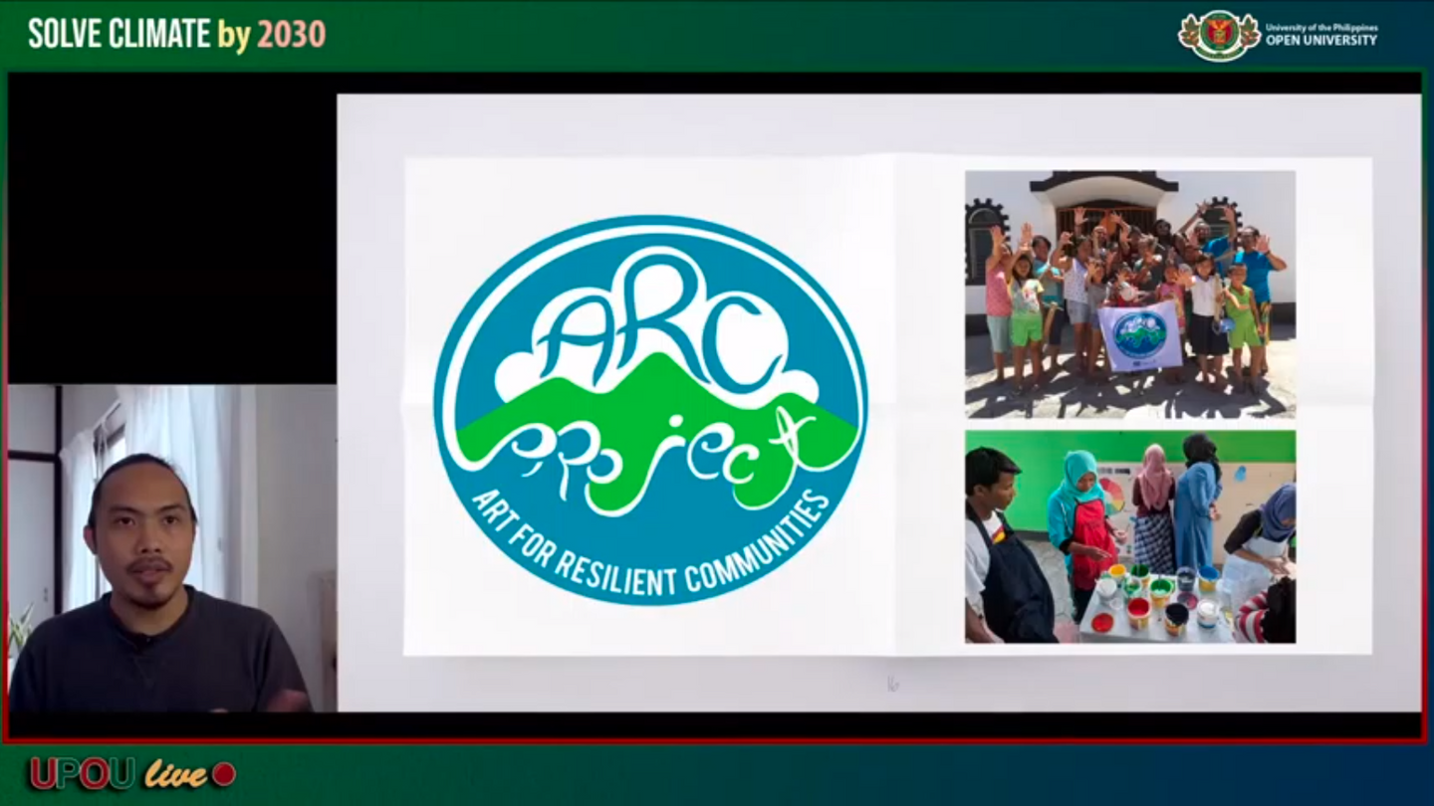
Teach-in Topics

Slide 23
Teach-in Topics
Biochemistry: How does eating red algae keep cows from belching methane? Could we engineer enzymes that could capture atmospheric carbon for use in building materials?

Slide 24
Teach-in Topics
Biology: how do biological systems (ecosystems, human bodies) respond to climate effects like heat or drought? How can biological systems sequester carbon and what practices optimize this?

Slide 25
Teach-in Topics
Business: what are businesses doing to address the climate crisis? Which actions seem most effective and why? How can we tell what is "greenwashing" or what is a genuine commitment to the common good?

Slide 26
Teach-in Topics
Chemistry: how does a greater concentration of CO2 in the atmosphere affect the chemistry of the ocean (and, in turn, affect the creatures living there)? How does heat in the atmosphere affect its ability to hold water?

Slide 27
Teach-in Topics
Computer science: How do computer scientists model climate outcomes and what are they doing to improve their predictions? What is the climate impact of all those data centers (or bitcoin??) and how is the field working to make it better?

Slide 28
Teach-in Topics
Creative writing: Climate literature, stories, poetry - how effective are these at raising awareness? Can you write your own climate literature? (i.e. Craig Santos Perez)

Slide 29
Teach-in Topics
Economics: How is the fossil fuel industry reinventing itself in response to the climate crisis? What pricing mechanisms would work to wean our society off of fossil fuels?

Slide 30
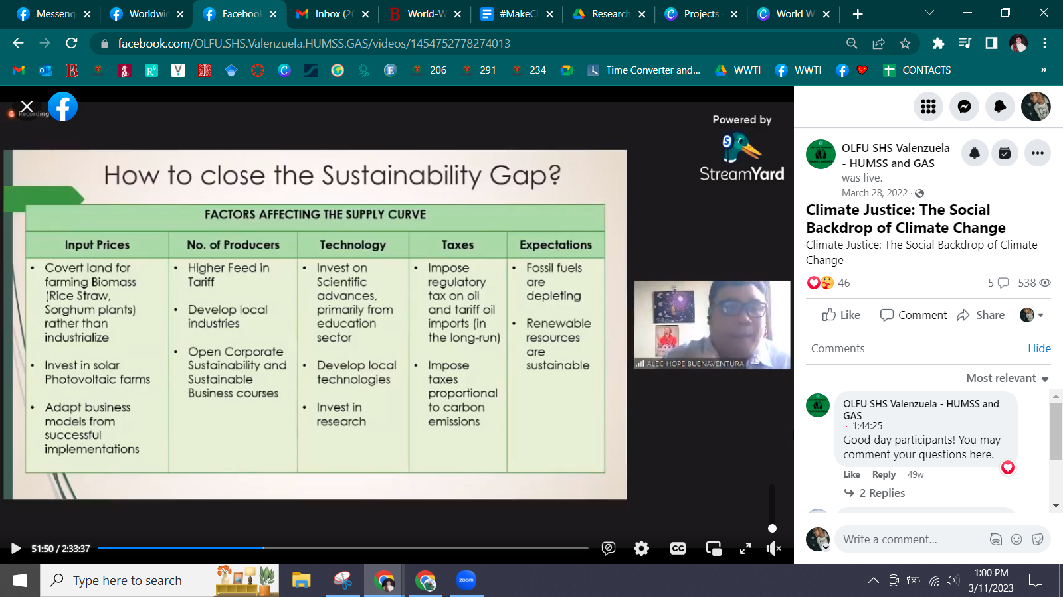
Teach-in Topics

Slide 31
Teach-in Topics
Education: What do students need to know about the climate crisis? What is an age-appropriate way to talk about impending cataclysm? How can environmental education foster a new generation of climate leaders? How can insights from education inform the climate movement's efforts to raise awareness throughout society?

Slide 32
Teach-in Topics
Engineering: What alternatives to fossil fuel have the most promise and why? Which buildings on campus are the most energy efficient and how can the others be improved?

Slide 33
Teach-in Topics
English (literature): Read some cli-fi (climate fiction) or solarpunk (imagining greener futures) and discuss the effects of this genre of literature. (i.e. Flight Behavior by Barbara Kingsolver.)

Slide 34
Teach-in Topics
Gender and Women's Studies: why are women more vulnerable to climate effects than men? Why are polluting practices and industries associated with masculinity? (think Rolling Coal trucks, eating meat... these are typically masculine pursuits.) Would smashing the patriarchy save the planet??

Slide 35
Teach-in Topics
Health and Exercise Science: What are the effects of extreme heat and other weather events on the human body? How can more active transportation (walking, biking) help solve the climate crisis and what can be done to promote this?

Slide 36
Teach-in Topics
History: When has climate been different in the past and how have people responded to it?

Slide 37
Teach-in Topics
Human Resources: What policies and practices can respond to the climate crisis (e.g. telework)? What is the future of work on a warming planet?

Slide 38
Teach-in Topics
International Relations: What do you make of the United Nations Framework Convention on Climate Change? How effective is the Paris Agreement (2015)? Should richer countries have to pay for climate adaptation in poorer countries?

Slide 39
Teach-in Topics
Legal Studies: Analyze the National Renewable Energy Program. Should it be ammended? If yes, what are your policy recommendations?

Slide 40
Teach-in Topics
Math: How do scientists use math to analyze the climate or predict climate effects? How do you respond to McKibben's article "Global Warming's Terrifying New Math" (2012)?

Slide 41
Teach-in Topics
Marketing: How have fossil fuel companies sown doubt about climate change through clever public relations strategies? How can marketers use their powers for good, to support action on climate?

Slide 42
Teach-in Topics
Music: Listen to and analyze recent works dealing with climate change (recommended: Ludovico Einaudi's 'Elegy for the Arctic'; pieces linked from the Forbes article "What does Climate Change Sound Like As Music?")

Slide 43
Teach-in Topics
Philosophy: Is it the place of human beings to engineer the climate in response to climate change? What is our human role in this earth system?

Slide 44
Teach-in Topics
Physics: Which greenhouse gases trap the most heat and why? What is the principle behind solar radiation management and do you think it would work? Compare and contrast different types of renewable energy.

Slide 45
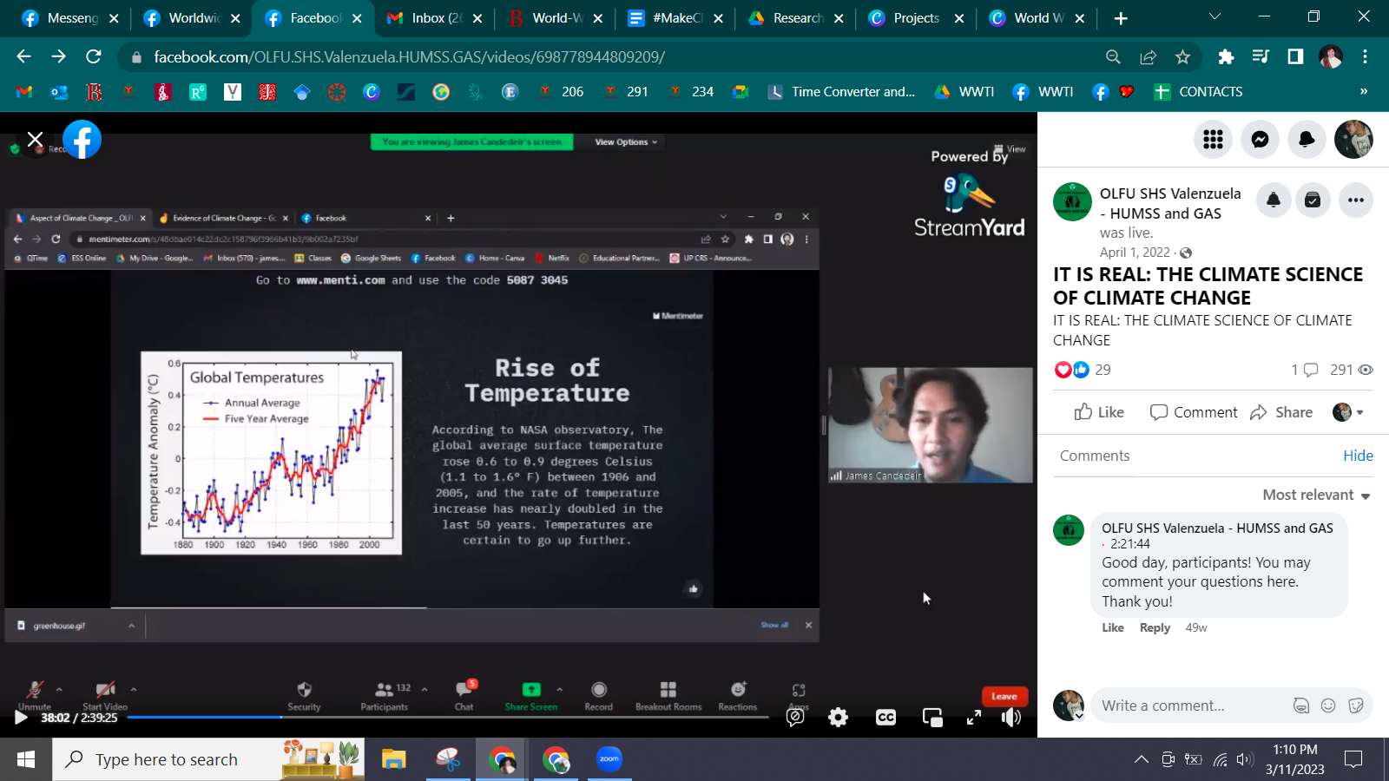
Teach-in Topics

Slide 46
Teach-in Topics
Political Science: Study the geo-political backdrop of climate change.

Slide 47
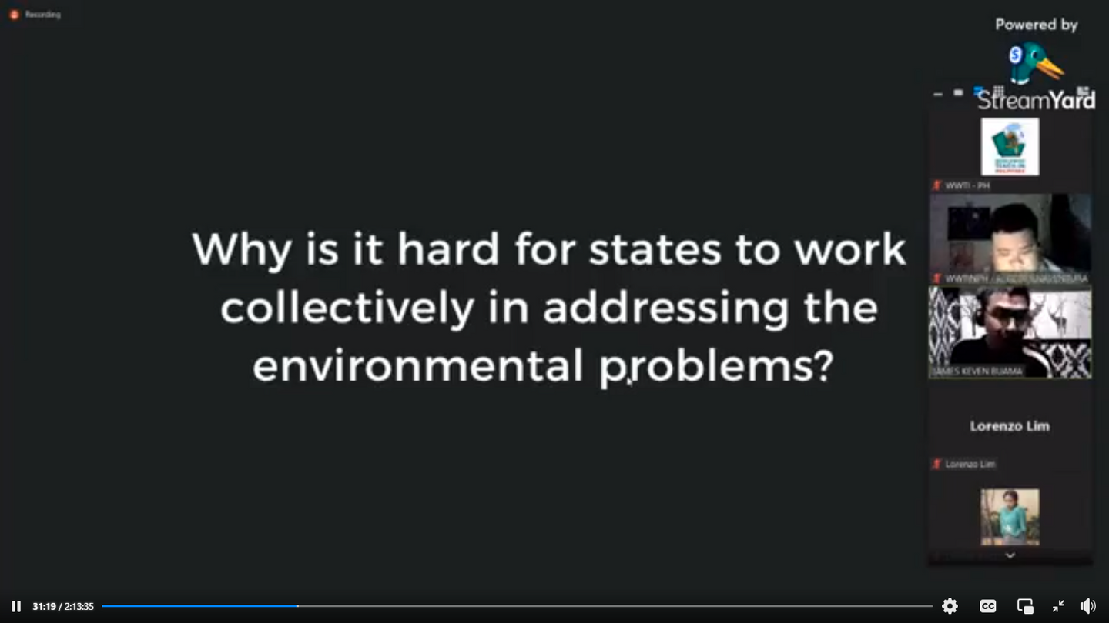
Teach-in Topics

Slide 48
Teach-in Topics
Psychology: What are the mental health effects of climate change (see recent APA report)? What is the role of psychologists in addressing this crisis?

Slide 49
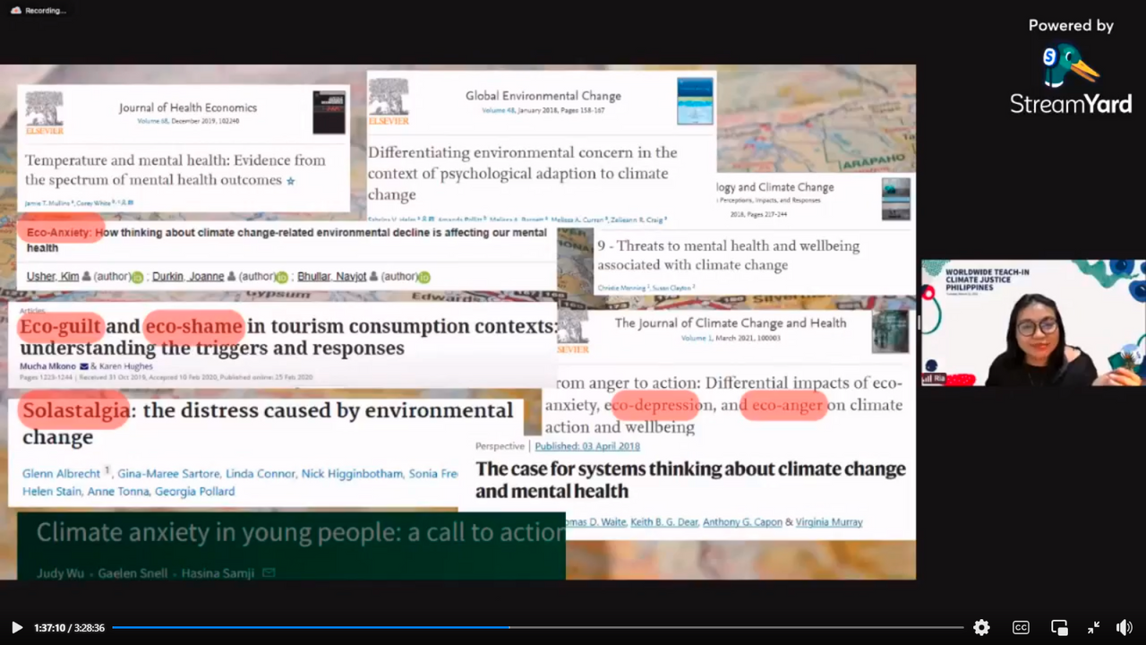
Teach-in Topics

Slide 50
Teach-in Topics
Sociology: Scientists have known for decades what should be done in response to the climate crisis, and haven't been quiet about it. And yet, the crisis gets worse by the year. What factors in society are keeping us from doing the right thing?

Slide 51
Teach-in Topics
Statistics: Analyze climate data (the international monetary fund's climate change dashboard is a good place to start).

Slide 52
Teach-in Topics
Theatre: Read/perform a play about climate change (try “The Trials” by Dawn King); what is the role of theatrical performance in opening conversations about difficult topics? How can a medium like theatre bring a "personal" element to something so vast and global

Slide 53
Teach-in Topics
Theatre: Read/perform a play about climate change (try “The Trials” by Dawn King); what is the role of theatrical performance in opening conversations about difficult topics? How can a medium like theatre bring a "personal" element to something so vast and global

Slide 54
MAKING THE ASK

Slide 55
THE ASK
We invite you to conduct your own Climate Teach-in!

Slide 56
THE ASK
Coordinate with us!
Register your Teach-in here:
https://earthday.maps.arcgis.com/apps/dashboards/3099472c8d794908917c23d06dffd2cb

Slide 57
THE ASK
As you participate by making climate a class, you will receive an International Certificate of Appreciation from Bard College, New York and will be an official partner of Worldwide Teach-in for Climate and Justice Program

Slide 58
Keep in touched
Facebook Page: Worldwide Teach-In for Climate PH
Instagram: https://www.instagram.com/worldwideteachin_ph
Twitter: https://twitter.com/wwteachin_ph
Website: worldwideteachin.org
Email: worldwideteachinph@gmail.com

Slide 59
FOR CLIMATE JUSTICE,
THANK YOU!

