Slide 1


LESSON PLAN
Anak ng Pasig
This lesson plan is created by: Toni S.

Slide 2
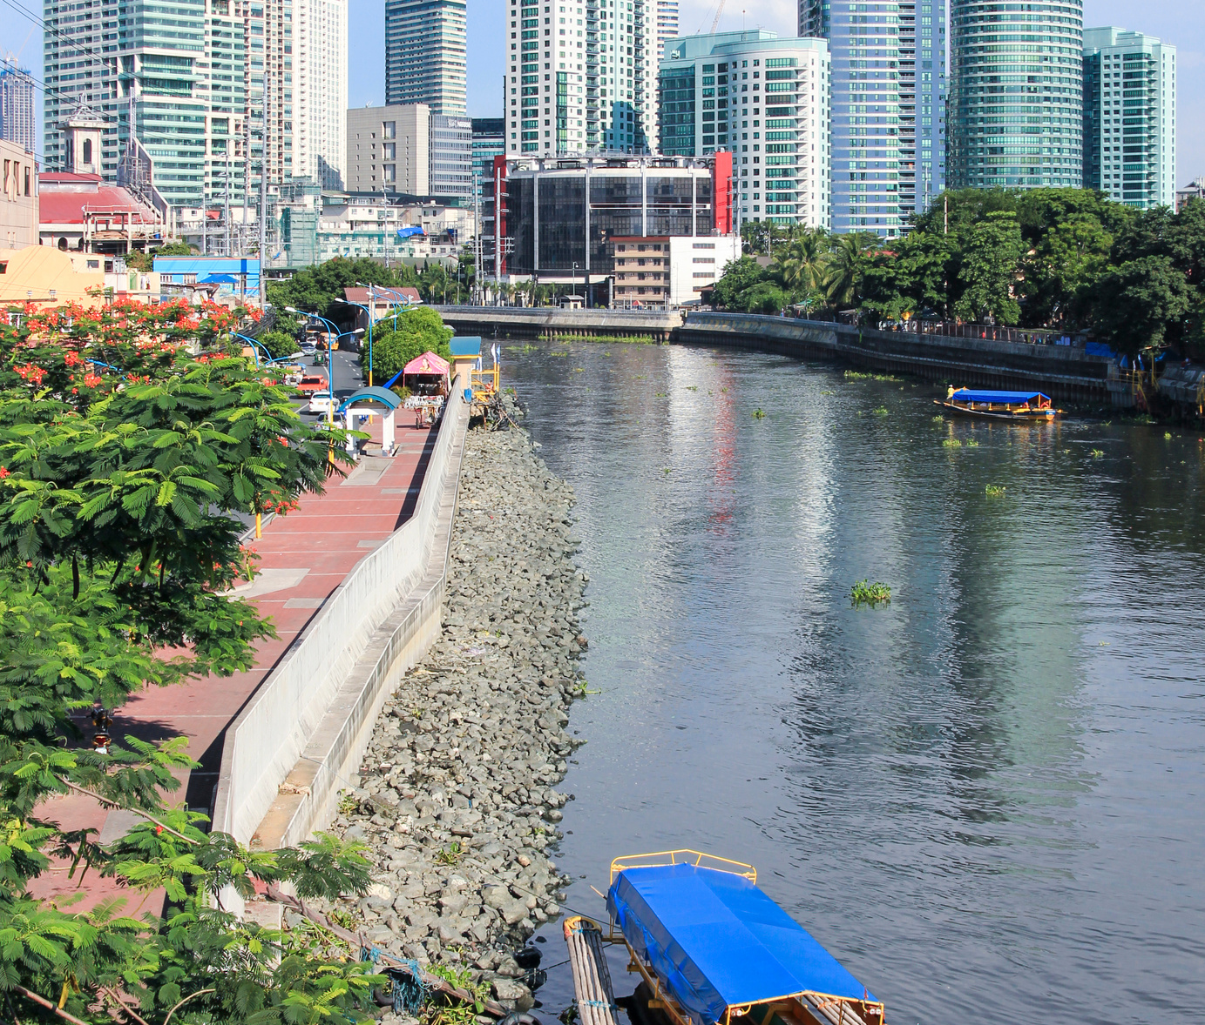

PASIG RIVER
Pasig River is a historical and ecological landmark of great significance in the Philippines.
It has sadly earned the nickname of "Metro Manila's sewage system" due to the substantial volume of waste discharged into its waters. Despite the government's initiatives to enhance the condition of the Pasig River, the situation persists in deteriorating over time.

Slide 3

GOAL OF THIS LESSON PLAN
To understand the history of the Pasig River revitalization & initiate a conversation on the importance of maintaining river systems in the Philippines.

Slide 4
Grade Levels:
7th, 8th, 9th, 10th, 11th, 12th
Duration:
50 MINUTES
“ANAK NG PASIG”
OBJECTIVES
  To understand the history of the Pasig River revitalization and its importance
  To connect with the environment through the song “Anak ng Pasig”
  To initiate a conversation on the importance of maintaining river systems in the Philippines

Slide 5

RESOURCES
  “Anak ng Pasig” song lyrics
  “The Pasig River Today” video
  For 11th and 12th grade: additional resource (research paper)

Slide 6


QUESTIONS FOR REFLECTION
  What is the moral of the song?
  What did you feel after listening to the song? How about after
watching the video of rehabilitation?

Slide 7
INTRODUCTION
  Play the “Anak ng Pasig” song twice
  Discuss initial ideas from the song
  Play the video (rehabilitation)
Duration:
15 MINUTES

Slide 8
ANALYZE
  Group the students into 3-4 groups (depending on class size)
  Each group must discuss on what they have listened to and the video they watched.
  They must come up with a 3-minute role play showcasing what was the problem (based on the song) and what was the solution (based on the video).
Duration:
15 MINUTES

Slide 9
DISCUSSION / COLLABORATION
  Group Presentation
  After all the groups have presented, discuss the scenarios that they came up with and allow conversations around the classroom.
  Use the remaining time to talk about their performances.
Duration:
15 MINUTES

Slide 10
ASSESSMENT / REFLECTION
Call 2-3 students to **answer the Questions for Reflection**
** Follow up as an assignment if possible.
Duration:
5 MINUTES

