Slide 1
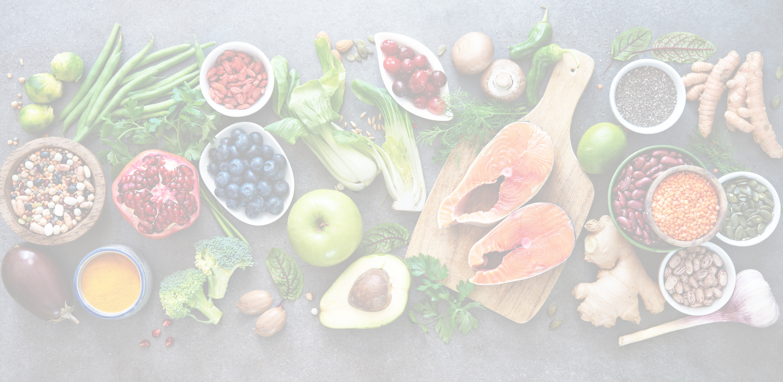

LESSON PLAN
PAGKAIN
This lesson plan is created by: Toni S.

Slide 2
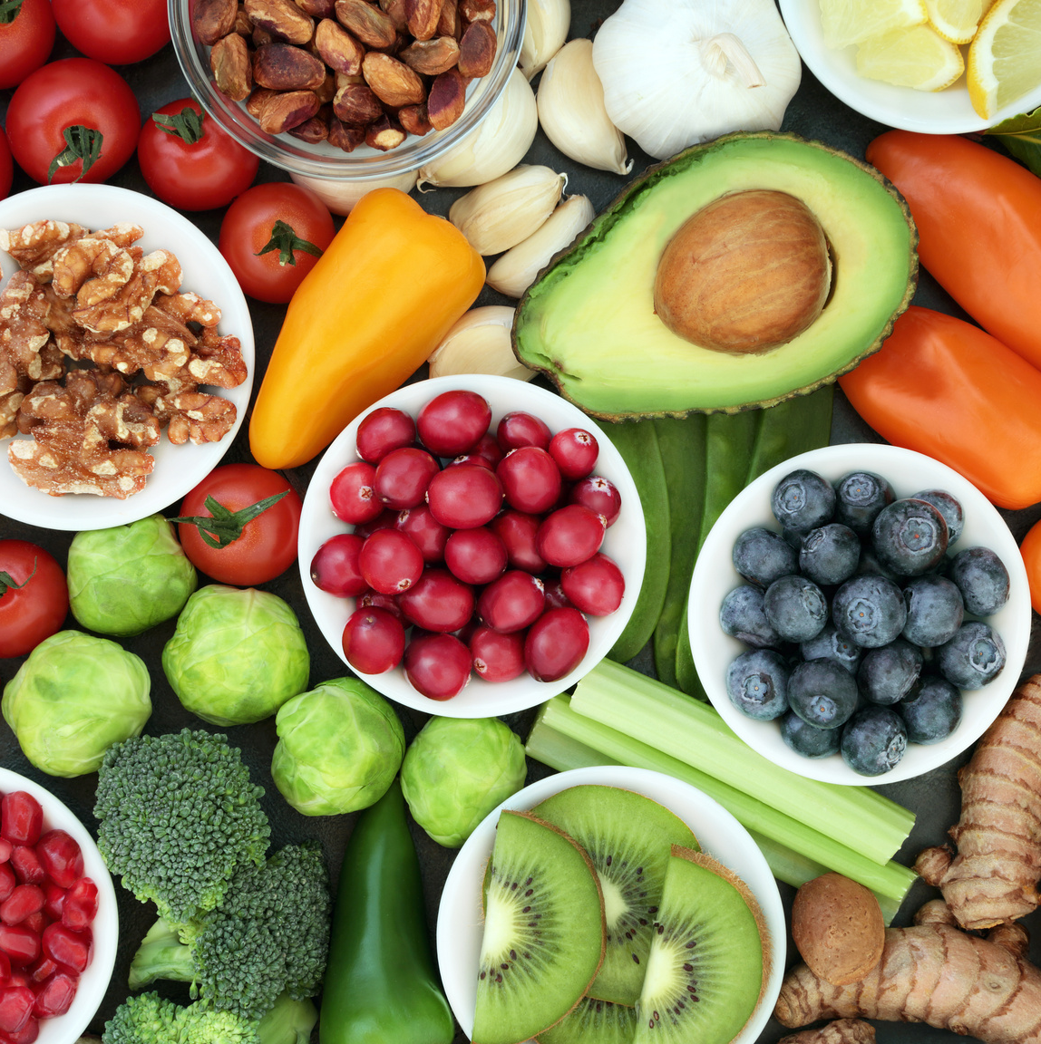

PAGKAIN
“Pagkain” is the Filipino term for “food” in English.
The issue of food waste in the Philippines is a growing concern, as a significant amount of food is discarded and goes to waste each year, despite high levels of food scarcity in other areas. This lesson is focused on the importance of food and is designed for young learners.

Slide 3

GOAL OF THIS LESSON PLAN
To talk about and understand the importance of not wasting food and how it is related to the environment.

Slide 4
Duration:
60 MINUTES
Grade Levels:
1st, 2nd, 3rd, 4th, 5th
PAGKAIN
OBJECTIVES
  To understand the importance of not wasting food
  To learn about how food waste is related to the climate/environment
  To reflect on our food consumption and food waste

Slide 5
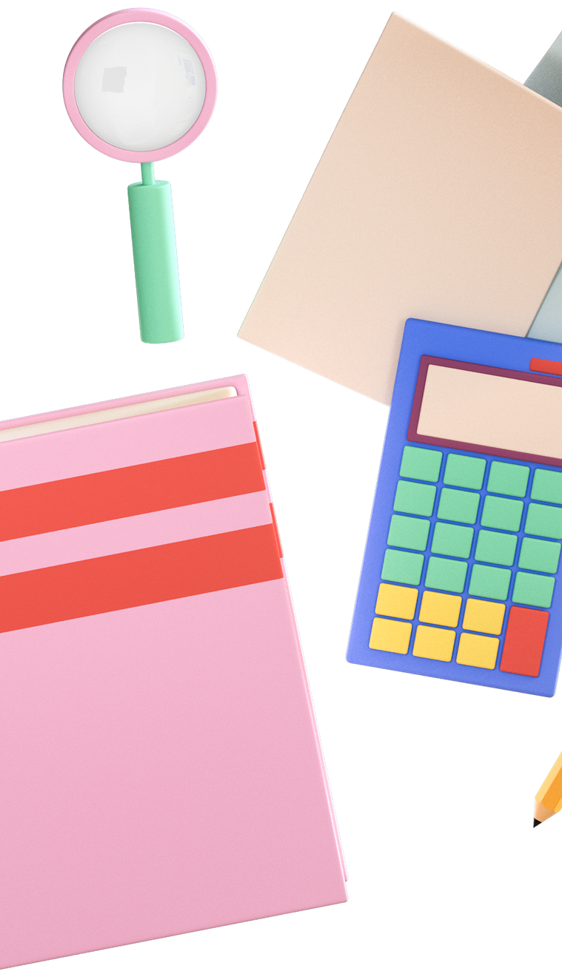
RESOURCES
  Youtube Video: Do Not Waste Food
  Youtube Video: Food Waste Prevention
  PBS Kids Game: Vegetable Planting

Slide 6

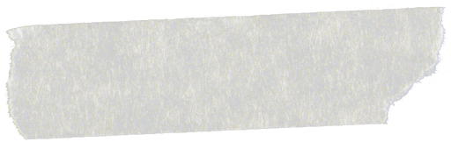
QUESTIONS FOR REFLECTION
  What did you feel after watching the videos?
  Who are the people affected by food waste?
  Why is it important not to waste food?

Slide 7
INTRODUCTION
  Ask the students if they are aware of “food waste”
  Play Video 1
  Play Video 2
  Play the game together with the whole class (explaining/conversing as you play)
Duration:
20 MINUTES

Slide 8
ANALYZE
  Activity for students:
Write a letter addressed to an adult or a grownup (your parent, teacher, city mayor, country president, a celebrity you look up to, etc.) and tell them about what you have learned from the videos and the game. Tell them that you need help from them in addressing the problem of food waste and let them know if you also want to help or if you have an idea on how to prevent food waste.
Duration:
15 MINUTES

Slide 9
DISCUSSION / COLLABORATION
  Call 2-3 students to read their letter out loud.
  Discuss and converse with the students about the important things they have written on their letter.
Duration:
15 MINUTES

Slide 10
ASSESSMENT / REFLECTION
Answer the questions for reflection together.
Duration:
10 MINUTES

